Slide 1
LEADERSHIP
Session 29

Slide 2
Leadership is an art or process of influencing people so that they will strive willingly and enthusiastically toward the achievement of group goals.
Leadership is a practical skill encompassing the ability of an individual or organization to "lead" or guide other individuals, teams, or entire organizations.
Although some people treat the terms managership and leadership as synonyms, the two should be distinguished.

Slide 3
The essence of leadership is follwership. In other words, it is the willingness of people to follow that makes a person a leader.
Moreover, people tend to follow those whom they see as providing a means of achieving their own desires, wants and needs.
Leadership and motivation are closely interconnected.

Slide 4
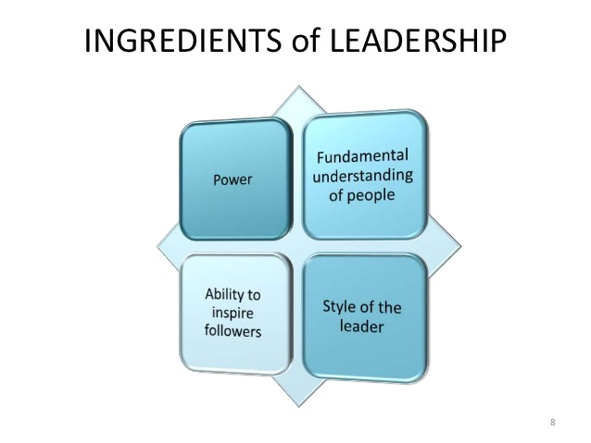

Slide 5
Principle of Leadership
The fundamental principle of leadership is this: since people tend to follow those who, in their view, offer them a means of satisfying their personal goals, the more managers understand what motivates their subordinates and how these motivators operate.

Slide 6
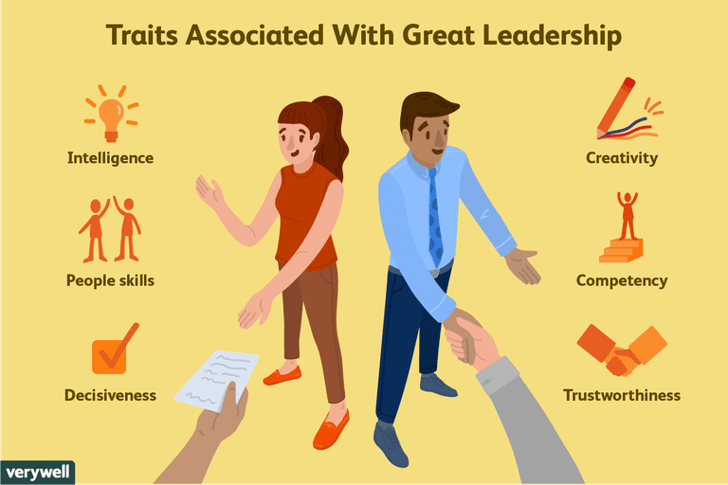

Slide 7
Charismatic leadership
Charismatic leadership is basically the method of encouraging particular behaviors in others by way of fluent communication, persuasion and force of personality.
Charismatic leaders motivate followers to get things done or improve the way certain things are done. This is accomplished by conjuring up eagerness in others to achieve a stated goal or vision.
In essence, the charismatic leadership style has its basis in a form of heroism. This leadership style is almost of divine origin. Example: Mahatma Gandhi, Mother Teresa

Slide 8
Leadership styles
Autocratic leader(Adolf Hitler)
Democratic or Participative(Mahatma Gandhi)
Free-rein leader(Steve Jobs)

Slide 9
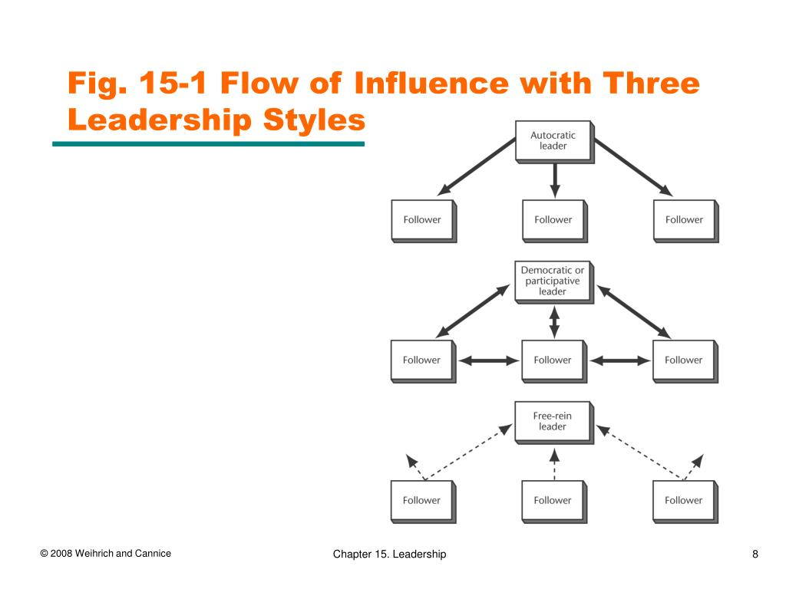

Slide 10
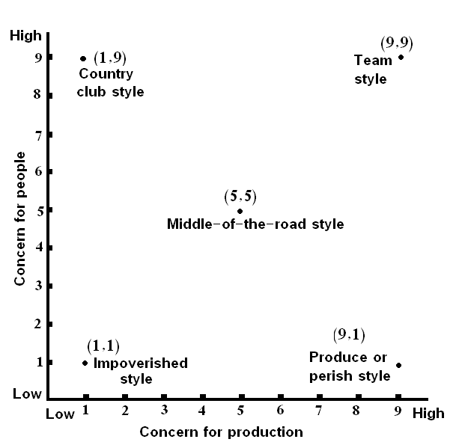
The Managerial Grid

Slide 11
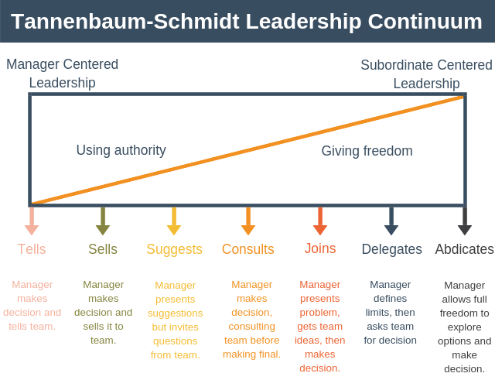
Leadership as a Continuum

Slide 12
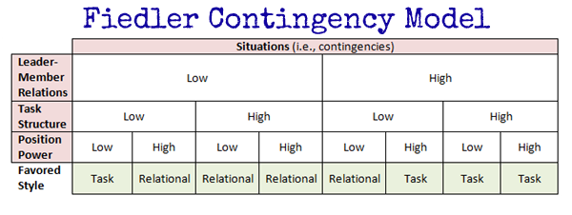

Slide 13
Examples of Contingency theory
Example 1: PizzaHut Restaurant Manager
In this example, we’re going to imagine that you have been newly appointed the manager of a PizzaHut restaurant. In this scenario we might expect the following situational factors:
Trust will be low. This is because you are new to the job so your team won’t trust you. Secondly, staff turnover is high so it’s going to be difficult to build strong relationships.
Task structure is high. This is because there are extremely clear operating procedures to follow covering everything from how to make each pizza, to how to welcome customers to the restaurant.
Position power is high. You have the ability to hire and fire and reward and punish as is required.
According to Fiedler’s Contingency Theory of Leadership, and using our table above, a relationship-oriented leader is best suited to this type of role.

Slide 14
Example 2: Software Development Manager
In this example, we’re going to imagine that you’ve just been promoted to be the manager of a software development team you’ve been working in for two years.
In this scenario, the situational factors might look something like this:
Trust will be high. You’ve already worked with the team for two years, know each of the team members well, and they trust you.
Task structure is high. Even though software development is complex, task structure is high as the team knows what they have to do each week.
Position power is low. Although you’ve been promoted to manage the team’s day to day work, you are not responsible for line managing any of them. Thus, you don’t hold much formal authority over any of them.
According to Fiedler’s Contingency Theory of Leadership, and using our table above, a task-oriented leader is best suited to this type of role.

Slide 15
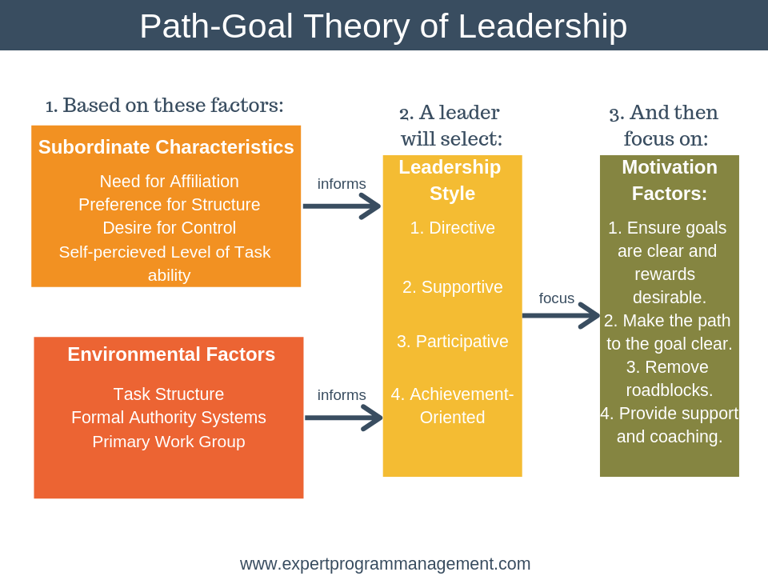

Slide 16
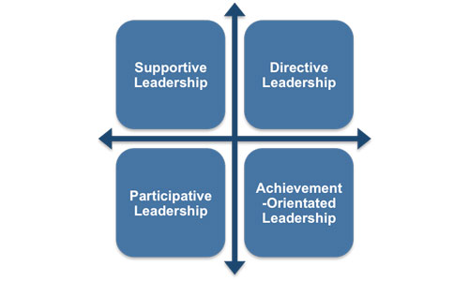
Theory categorizes leader behavior into four groups

Slide 17
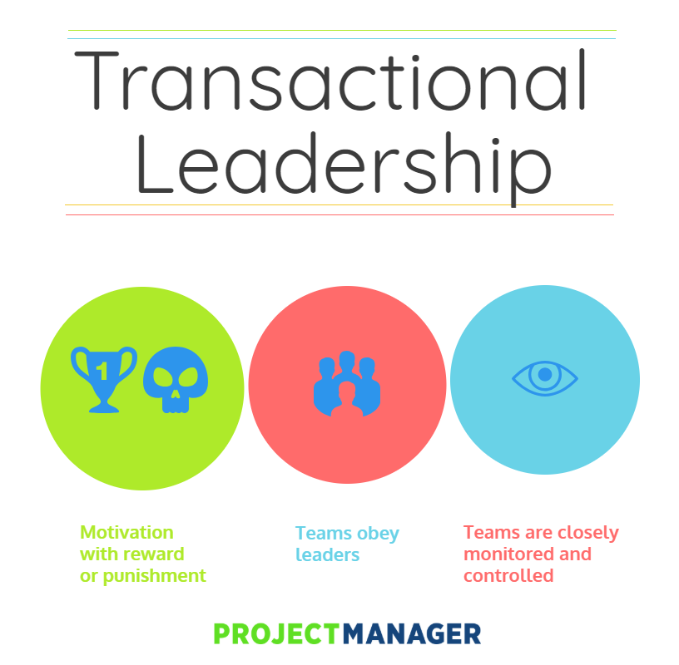
Transactional Leadership

Slide 18
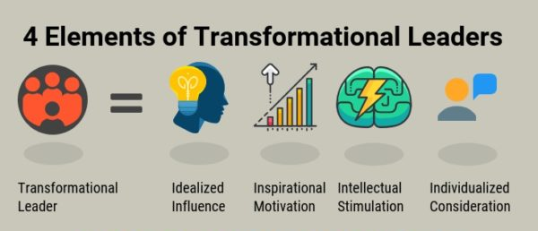
Transformational leadership

Slide 19
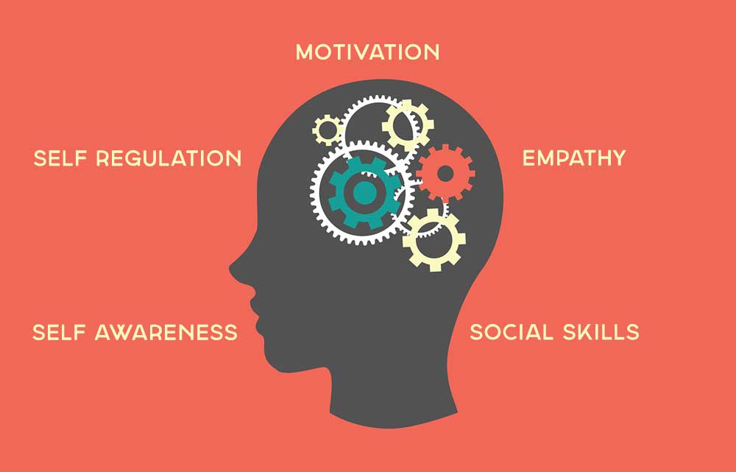
Emotional intelligence approach to leadership

